Slide 1
Bridging AI and Surgery: Exploring Reinforcement
Learning in Surgical Contexts
Can Reinforcement Learning Be Applied to Surgery?
Antonio Damiano - antonio.damiano3@studio.unibo.it

Slide 2
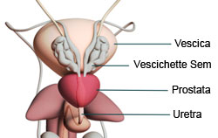
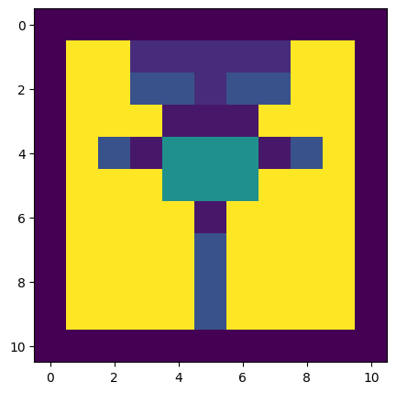
INTRODUCTION
PROSTATECTOMY ENVIRONMENT
REWARDS
This project investigates the synergy between AI and surgery, utilizing reinforcement learning and deep neural networks to enhance surgical techniques. Through 2D surgical simulations and a rigorous exploration of AI's role.
Rewards based on the cut tissue:
Board -> -5
Bladder or prostate -> -5
Target points -> +10
Points to avoid -> -3
Peritoneum -> 1

Slide 3
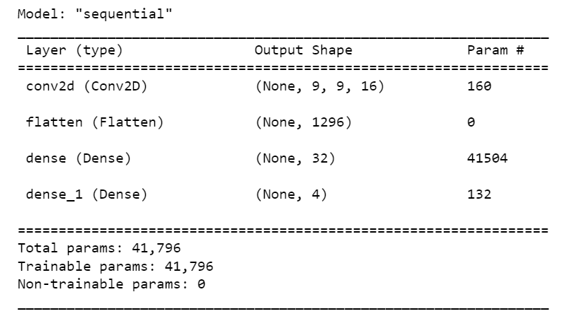
AGENT
ISSUES
The agent uses a Q-learning variant for training, including experience replay and updates based on the Bellman equation. An epsilon-greedy strategy balances exploration and exploitation.
The agent employs a neural network to approximate the action-value function (Q-function) for RL. The model takes the current environment state as input and outputs Q-values for possible actions.
Time and resources

Slide 4
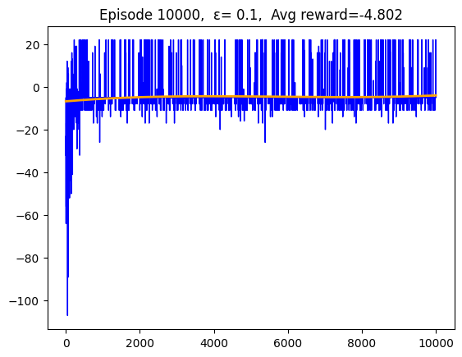
RESULTS
While the initial results may fall short of expectations, there's significant potential for improvement. Employing advanced techniques, optimizing hyperparameters, and extending training can enhance the agent's surgical proficiency. Notably, the training reward trend line indicates a lack of convergence to the optimal solution, suggesting room for further refinement.

